Slide 1
COVID-19 Cases-part-2
File created on: 27-03-2020 23:46:37

Slide 2
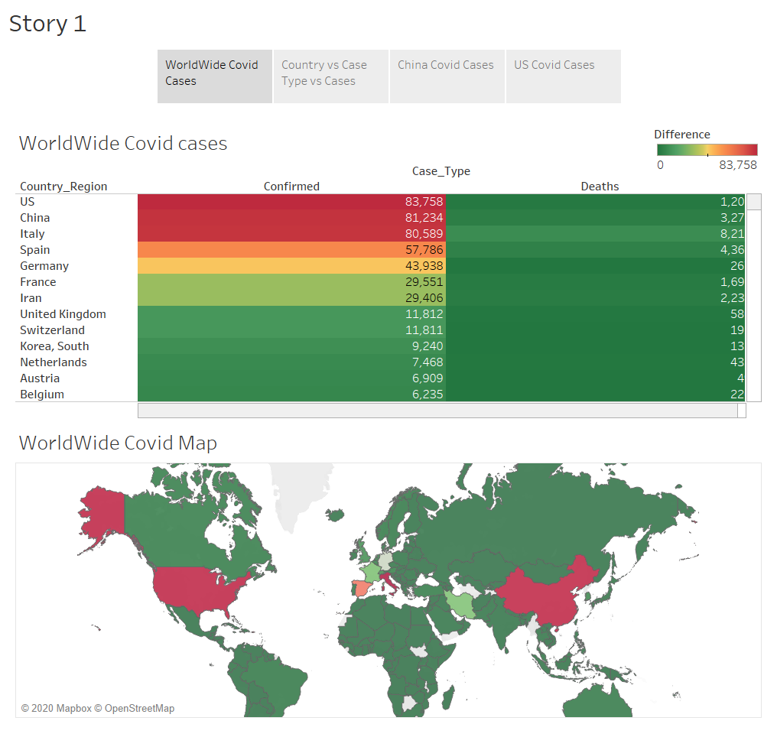

Slide 3
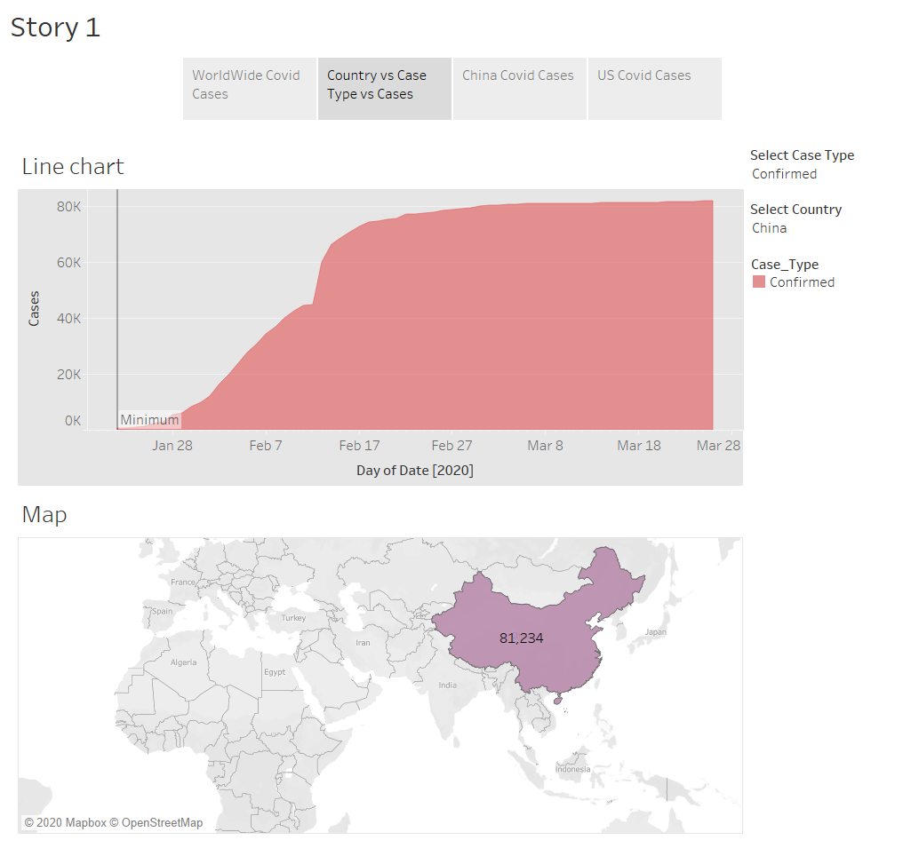

Slide 4
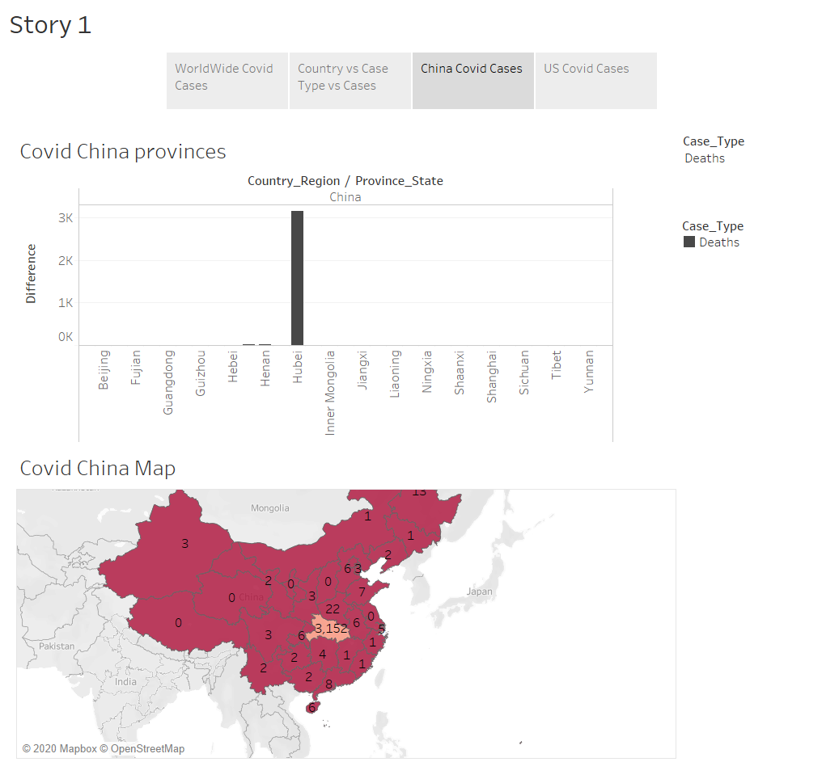

Slide 5
